Slide 1
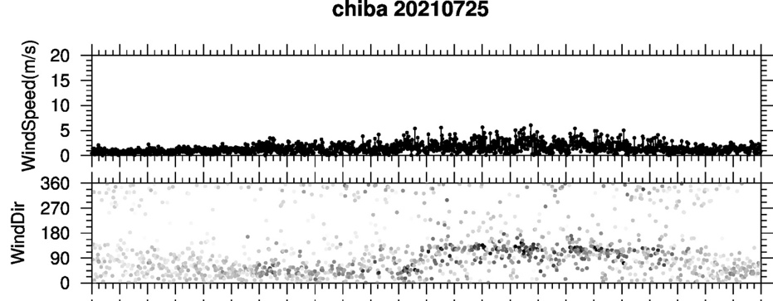
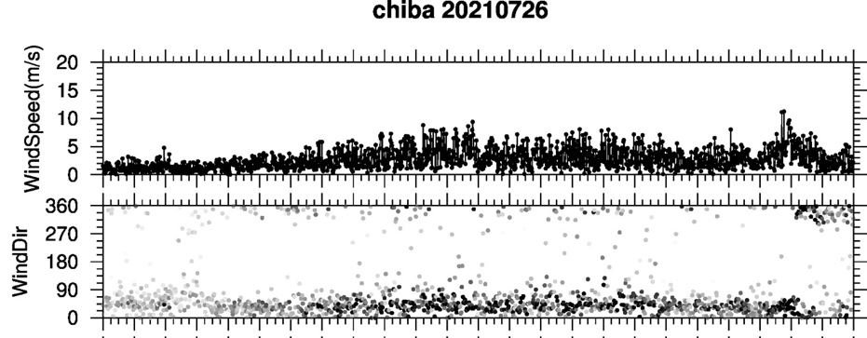
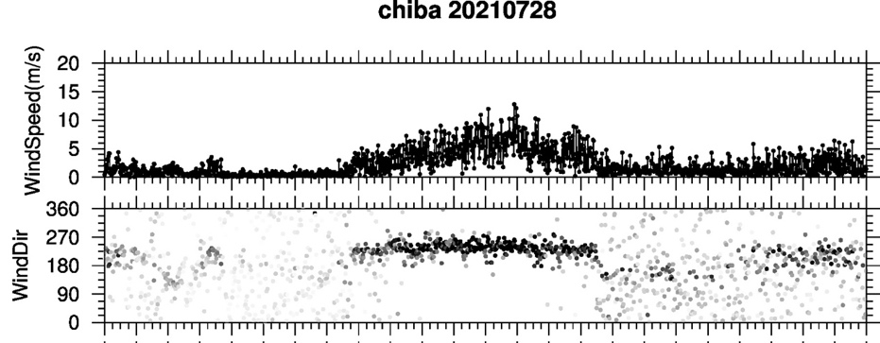
Ozone variability during the Chiba campaign 2021
MAX-DOAS O₃ compared with a box model during the Chiba Campaign (left). Simulations roughly reproduced the O₃ trend except for 28/07, when an intense southwest wind (right) bringing clean maritime air masses into the Tokyo Bay area potentially lowered by half the observed [O₃].
25 July
26 July
28 July
MAX-DOAS O₃ partial column (< 1 km; cicles) simulated with a box model accounting for boundary layer dynamics and chemistry i.e., Chemistry Land-surface Atmosphere Soil Slab (CLASS) model (van Stratum et al., 2012). Simulations (lines) used the atmospheric boundary layer height, [NO2] and [HCHO] observed at the early morning as initial conditions.

